Slide 1
DDMA DPU Diagrams

Slide 2
RxAnt
1 | 2 | 3 | 4
1 | 2 | 3 | 4
1 | 2 | 3 | 4
Range Bins Per Block
Block 1
Block 2
Block 3
Block nBlock
RangeBin
Block
Range bins per block = x
Rx Antenna per block = 4
nBlock = nRangeBin/x

Slide 3
RangeBin
Block
1 | 1 | 1 | 1
2 | 2 | 2 | 2
3 | 3 | 3 | 3
4 | 4 | 4 | 4
1
2
3
4
Block 1
Block 1
Block 1
Block 1
Block 2
Block 2
Block 2
Block 2
Block N
Block N
Block N
Block N
RxAnt
RxAnt
Range bins per block = 4
Rx Antenna per block = 1
nBlock = nRangeBin*nRxAnt/4 = nRxAnt * N

Slide 4
Outer Block
Block 1
Block 2
Block 3
Block nBlock
Block 1
Block 2
Block 3
Block nBlock
Block 1
Block 2
Block 3
Block nBlock
Block 1
Block 2
Block 3
Block nBlock
Block 1
Block 2
Block 3
Block nBlock
Block 1
Block 2
Block 3
Block nBlock
Block 1
Block 2
Block 3
Block nBlock
Block

Slide 5
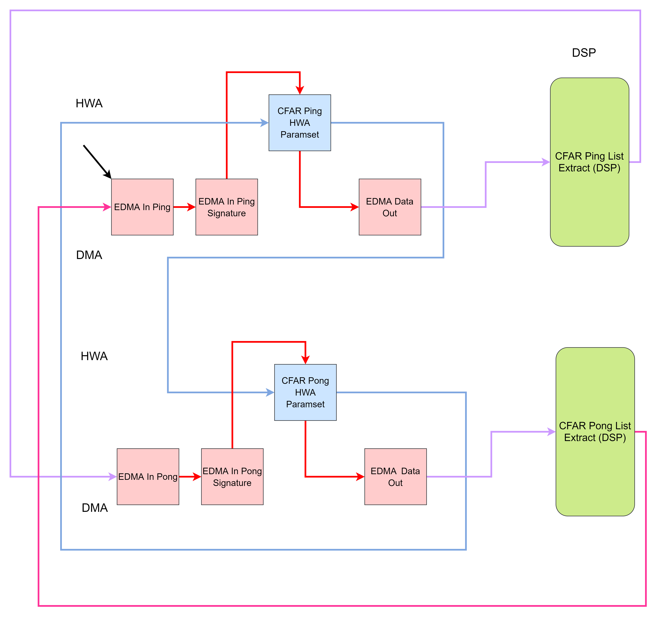
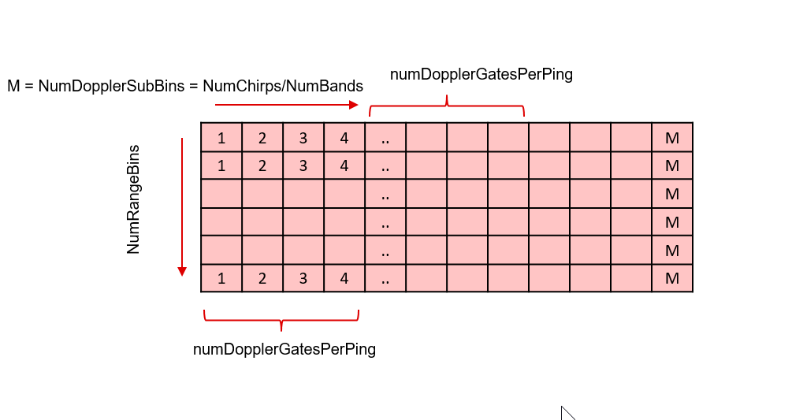

Slide 6
NumRangeBins
numDopplerGatesPerPing
M = NumDopplerSubBins = NumChirps/NumBands
1 | 2 | 3 | 4 | .. |  |  |  |  |  |  | M
1 | 2 | 3 | 4 | .. |  |  |  |  |  |  | M
 |  |  |  | .. |  |  |  |  |  |  | M
 |  |  |  | .. |  |  |  |  |  |  | M
 |  |  |  | .. |  |  |  |  |  |  | M
1 | 2 | 3 | 4 | .. |  |  |  |  |  |  | M
numDopplerGatesPerPing

Slide 7
Doppler FFT DMA Transfer
Tx1 | Tx2 | Tx3 | Tx4
Tx1 | Tx2 | Tx3 | Tx4
Bin 1
Bin 2
..
Bin K/6
Bin K/6+1
Bin K/6+2
..
Bin 2K/6
Bin 2K/6+1
..
..
Bin 3K/6
..
..
Bin 4K/6
..
Bin 5K/6
..
Bin K
1 | 2 | 3 | 4
1 | 2 | 3 | 4
.. | .. | .. | ..
1 | 2 | 3 | 4
Band 1
Band 1
..
Band 1
Band 2
Band 2
..
Band 2
Band 3
..
..
Band 3
..
..
Band 4
..
Band 5
..
Band 6
Band 1
Band 2
Band 3
Band 4
Band 5
Band 6
Band 1
Band 2
Band 3
Band 4
Band 5
Band 6
..
Band 1
Band 2
Band 3
Band 4
Band 5
Band 6
1 | 2 | 3 | 4
1 | 2 | 3 | 4
1 | 2 | 3 | 4
1 | 2 | 3 | 4
1 | 2 | 3 | 4
1 | 2 | 3 | 4
1 | 2 | 3 | 4
1 | 2 | 3 | 4
1 | 2 | 3 | 4
1 | 2 | 3 | 4
1 | 2 | 3 | 4
1 | 2 | 3 | 4
.. | .. | .. | ..
1 | 2 | 3 | 4
1 | 2 | 3 | 4
1 | 2 | 3 | 4
1 | 2 | 3 | 4
1 | 2 | 3 | 4
1 | 2 | 3 | 4
Bin 1
Bin K/6+1
Bin 2K/6+1
Bin 3K/6+1
Bin 4K/6+1
Bin 5K/6+1
Bin 2
Bin K/6+2
..
..
..
Bin 5K/6+2
..
Bin K/6
Bin 2K/6
..
..
..
Bin K
Dop SubBin 1
1 | 2 | 3 | 4
1 | 2 | 3 | 4
.. | .. | .. | ..
1 | 2 | 3 | 4
1 | 2 | 3 | 4
.. | .. | .. | ..
.. | .. | .. | ..
1 | 2 | 3 | 4
Dop SubBin 2
.. | .. | .. | ..
.. | .. | .. | ..
1 | 2 | 3 | 4
.. | .. | .. | ..
1 | 2 | 3 | 4
Dop SubBin N
.. | .. | .. | ..
1 | 2 | 3 | 4

Slide 8
DDMA Metric
Tx1 | Tx2 | Tx3 | Tx4
Band 1
Band 2
Band 3
Band 4
Band 5
Band 6
Band 1
Band 2
Band 3
Band 4
Band 5
Band 6
..
Band 1
Band 2
Band 3
Band 4
Band 5
Band 6
1 | 2 | 3 | 4
1 | 2 | 3 | 4
1 | 2 | 3 | 4
1 | 2 | 3 | 4
1 | 2 | 3 | 4
1 | 2 | 3 | 4
1 | 2 | 3 | 4
1 | 2 | 3 | 4
1 | 2 | 3 | 4
1 | 2 | 3 | 4
1 | 2 | 3 | 4
1 | 2 | 3 | 4
.. | .. | .. | ..
1 | 2 | 3 | 4
1 | 2 | 3 | 4
1 | 2 | 3 | 4
1 | 2 | 3 | 4
1 | 2 | 3 | 4
1 | 2 | 3 | 4
Correspondence
DDMA Metric (arranged DopFFT bin wise)
1
2
..
K/6
K/6+1
..
2K/6
2K/6+1
..
3K/6
3K/6+1
..
4K/6
4K/6+1
..
5K/6
5K/6+1
..
K
Dop SubBin 1
Max
Rotation Index
Dop SubBin 2
Perform Copies
Dop SubBin N

Slide 9
DDMA Demod – Example
DopSubBin 1
MaxIdx = 5
1 | 2 | 3 | 4
1 | 2 | 3 | 4
1 | 2 | 3 | 4
1 | 2 | 3 | 4
1 | 2 | 3 | 4
1 | 2 | 3 | 4
Band 1
Band 2
Band 3 (Empty)
Band 4 (Empty)
Band 5
Band 6
Copy 2
1 | 2 | 3 | 4
1 | 2 | 3 | 4
1 | 2 | 3 | 4
1 | 2 | 3 | 4
Band 5
Band 6
Band 1
Band 2
Copy 1
1 | 2 | 3 | 4
1 | 2 | 3 | 4
1 | 2 | 3 | 4
1 | 2 | 3 | 4
Band 3
Band 4
Band 5
Band 6
DopSubBin 2
MaxIdx = 1
1 | 2 | 3 | 4
1 | 2 | 3 | 4
1 | 2 | 3 | 4
1 | 2 | 3 | 4
1 | 2 | 3 | 4
1 | 2 | 3 | 4
Band 1 (Empty)
Band 2 (Empty)
Band 3
Band 4
Band 5
Band 6
Copy
.. | .. | .. | ..
1 | 2 | 3 | 4
1 | 2 | 3 | 4
1 | 2 | 3 | 4
1 | 2 | 3 | 4
Band 2
Band 3
Band 4
Band 5
.. | .. | .. | ..
DopSubBinN
MaxIdx = 6
1 | 2 | 3 | 4
1 | 2 | 3 | 4
1 | 2 | 3 | 4
1 | 2 | 3 | 4
1 | 2 | 3 | 4
1 | 2 | 3 | 4
Band 1 (Empty)
Band 2
Band 3
Band 4
Band 5
Band 6 (Empty)
Copy

Slide 10
Compressed RadarCube – Format 2
Block 1
Block 1
Block 1
Block 1
Block 2
Block 2
Block 2
Block 2
Block N
Block N
Block N
Block N
RxAnt
Doppler Chirp 1
Tx1
Block 1
Block 1
Block 1
Block 1
Block 2
Block 2
Block 2
Block 2
Block N
Block N
Block N
Block N
RxAnt
Doppler Chirp 2
N Doppler Chirps
Block 1
Block 1
Block 1
Block 1
Block 2
Block 2
Block 2
Block 2
Block N
Block N
Block N
Block N
RxAnt
Doppler Chirp 1
Tx2
N Doppler Chirps
Block 1
Block 1
Block 1
Block 1
Block 2
Block 2
Block 2
Block 2
Block N
Block N
Block N
Block N
RxAnt
Doppler Chirp 1
Tx3
N Doppler Chirps

